Slide 1
CAReport design needs to be mobile responsive, thanks

Slide 2
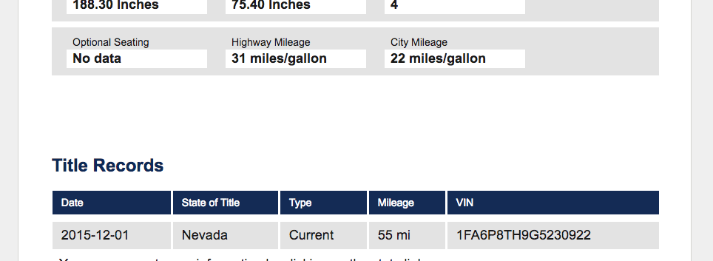
Too much space in between sections, please make this area a bit tighter

Slide 3
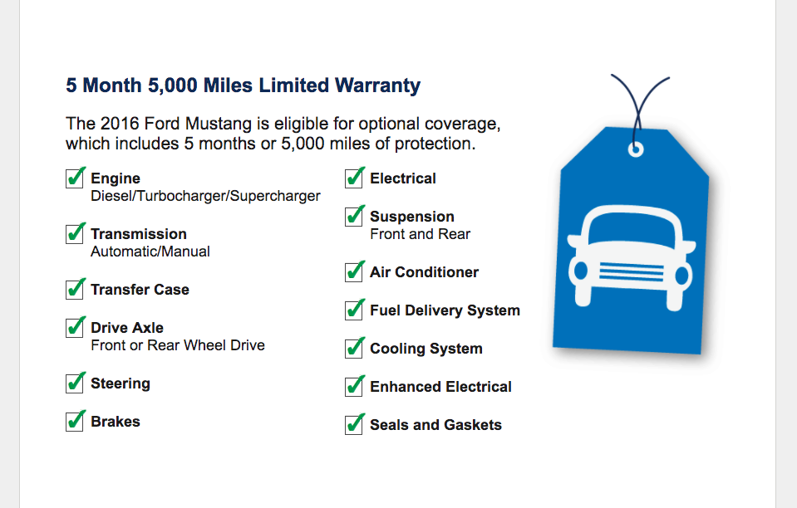
Delete this image
Move this section over a bit to the right so it has better spacing

